Slide 1
Week 2
Statistical analysis
Yoobee Colleges

Slide 2

Statistical Thinking
Learning Outcomes:
Understand the foundations of statistical thinking
Apply statistical concepts to real-world data
Recognize the role of data manipulation in analysis
Connect statistical methods to the scientific process

Slide 3

Introduction to Statistical thinking
Statistical thinking is a systematic way of thinking about how we describe the world and use data to make decisions and predictions.
This is done taking into account the inherent uncertainty that exists in the real world.
The foundations of statistical thinking come primarily from mathematics and statistics, but also from computer science, psychology, and other fields of study.
Statistics, in particular, is the discipline that concerns the collection, organization, analysis, interpretation, and presentation of data.

Slide 4

Statistical thinking and Human intuition
Human intuition often tries to answer the same questions that we can answer using statistical thinking but often gets the answer wrong.
For example, in recent years most Americans have reported that they think that violent crime was worse compared to the previous year.
However, a statistical analysis of the actual crime data shows that in fact violent crime has steadily decreased since the 1990’s.
Intuition fails us because we rely upon best guesses (which psychologists refer to as heuristics) that can often get it wrong.

Slide 5
The big ideas of statistics
There are a number of very basic ideas that cut through nearly all aspects of statistical thinking.
Learning from data
Aggregation
Uncertainty
Sampling from a population
Causality and statistics
Next, we examine each of them in more detail.

Slide 6
Learning from data
Patterns vs Noise: The goal is to identify real patterns in data, not be misled by random fluctuations.
Descriptive vs Inferential: Description helps summarize what you see; inference tries to generalize beyond what you see.
Context matters: Data doesn’t speak for itself. Understanding the context is key to drawing meaningful conclusions.
Exploration comes first: Initial data exploration helps shape hypotheses and highlights potential anomalies.
Feedback loops: Statistical analysis often involves refining models as more data is collected.
Modeling reality: Models simplify the world to help us understand and predict behavior.
Quantifying learning: We use metrics (like accuracy, error rates) to judge how well we’ve learned from data.
Continual updates: As new data comes in, conclusions should be revised accordingly.

Slide 7
Aggregation
Summarizing data: Means, medians, modes, and totals help reduce complex data to manageable summaries.
Group comparisons: Aggregation lets us compare across categories or time periods meaningfully.
Hiding variability: While useful, aggregation can mask important patterns and outliers.
Weighting matters: How values are combined (e.g., weighted averages) can change interpretations.
Roll-ups and drill-downs: Aggregated views support high-level decisions; detailed views support diagnostics.
Distribution awareness: Knowing the shape of the data (skewed, bimodal) is crucial before aggregating.
Combining dimensions: Aggregating across multiple variables helps reveal interactions and trends.
Aggregation ≠ simplification: It’s a tool, not the answer. Use it to clarify, not oversimplify.

Slide 8

Uncertainty
Inevitable: All statistical analysis involves uncertainty—never confuse estimates with exact values.
Confidence, not certainty: We use confidence intervals and probability to express how unsure we are.
Sources of uncertainty: Comes from measurement error, randomness, model assumptions, etc.
Quantified doubt: Statistics doesn’t eliminate uncertainty; it helps quantify and manage it.
Communicating uncertainty: Transparency around uncertainty improves decision-making and trust.
Prediction vs explanation: Uncertainty is different when you're trying to forecast vs understand.
Risk assessment: In real-world applications, managing uncertainty is more valuable than eliminating it.
Smaller samples = more uncertainty: The less data you have, the fuzzier your conclusions get.

Slide 9
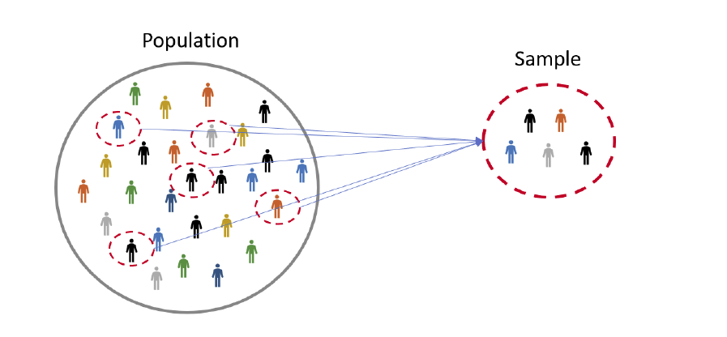
Sampling from a population
The concept of aggregation implies that we can make useful insights by collapsing across data.
But how much data do we need?
The idea of sampling says that we can summarize an entire population based on just a small number of samples from the population.
As long as those samples are obtained in the right way.

Slide 10

Activity - Beijing Multi-Site Air Quality
See activity for statistical analysis using Beijing Multi-Site Air Quality. See link: https://archive.ics.uci.edu/dataset/501/beijing+multi+site+air+quality+data
See tasks in the next slide …
Help link: https://royalsocietypublishing.org/rspa/article/473/2205/20170457/57438/Cautionary-tales-on-air-quality-improvement-in

Slide 11

Tasks- Activity - Beijing Multi-Site Air Quality- cont.
Task-1: Load and Inspect the Dataset
Load the dataset
Display the first 5 rows
Identify column names and data types
Count total rows and columns
Task-2: Data Cleaning
Identify missing values
Replace missing values
Remove rows if necessary
Task-3: Basic Statistical Analysis
Mean
Median
Minimum
Maximum
Standard deviation

Slide 12

Tasks- Activity - Beijing Multi-Site Air Quality- cont.
Task-4: Data Filtering
Filter data by station
Calculate average pollution levels
Task-5: Data Visualization
Histogram of PM2.5
Line plot of PM2.5 over time
Boxplot of pollutants
Task-6: Correlation Analysis
Which variable is most correlated with PM2.5?
Does temperature affect pollution levels?

Slide 13
Causality and statistics
Correlation ≠ Causation: Just because two variables move together doesn’t mean one causes the other.
Causal inference needs structure: Randomized experiments, longitudinal data, or causal models are required.
Confounding variables: Hidden factors can make it look like there’s a causal link when there isn’t.
Experiments vs observational data: Experiments offer cleaner causal insights; observational data needs caution.
Causal mechanisms: Explaining why something causes something else matters, not just showing an effect.
Counterfactual thinking: Causal questions ask: “What would have happened if X didn’t occur?”
Instrumental variables and natural experiments: When Randomized Controlled Trials (RCTs) aren’t possible, these tools help isolate causality.
Misleading causality is dangerous: Bad causal claims can lead to poor decisions, especially in policy and medicine.

Slide 14
What and why Statistical Thinking?
What can statistics do for us?
Describe: The world is complex and we often need to describe it in a simplified way that we can understand.
Decide: We often need to make decisions based on data, usually in the face of uncertainty.
Predict: We often wish to make predictions about new situations based on our knowledge of previous situations.
Why study statistics?
Scientists conduct research to answer questions, examine ideas, and test theories.
Statistics are relevant for quantitative research projects: numbers and data used as information
Statistics are mathematical techniques used by social scientists to analyze data in order to answer questions and test theories.

Slide 15

Importance of data manipulation
Studies with statistics
Data can be the most trustworthy information available to the researcher.
Researchers must organize, evaluate analyze data.
Without understanding of statistical analysis researcher will be unable to male sense of data.
Basic Statistical terms: Ratio, Proportion, Percentage Rate, Median, Mean, and Trend.
Studies without statistics
Some of the most important works in the social sciences do utilize statistics.
There is nothing magical about data and statistics.
Presence of numbers guarantees nothing about the quality of a scientific inquiry.
Basic terms: Observation, Opinion, Assumption, Story, Anecdote, and Feeling.

Slide 16
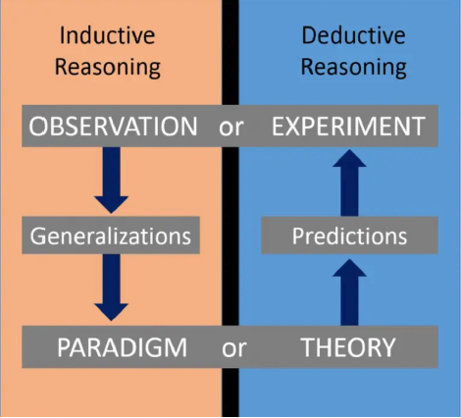
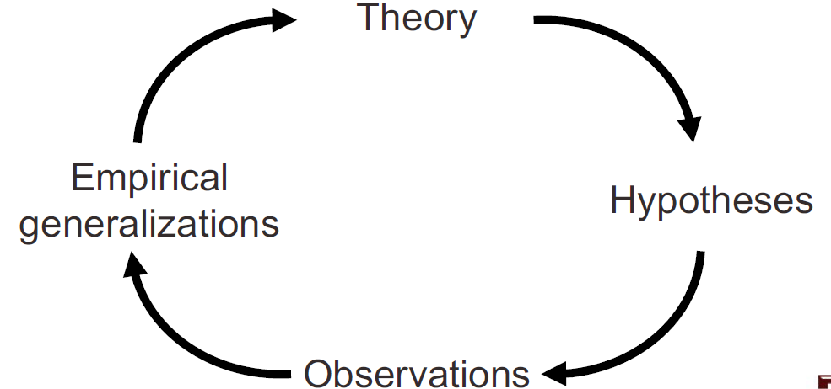
The Wheel of science
Scientific theory and research continually shape each other.
Inductive Reasoning | Deductive Reasoning
I start with data. | I start with theory.
I infer conclusions from data | I confirm a hypothesis
I tend to do qualitative research | I tend to do quantitative research

Slide 17
Statistical Analysis
Statistical analysis of data should be applied after successfully completing earlier phases
Rigorous conceptualization and use of theory
Well-defined research design and methods
Well-conceived research questions
Review research literature to learn how to
Develop and clarify definitions
Understand social concepts
Develop questions and indicators to measure concepts
In the normal course of science, we rarely are in a position to declare a theory true or false
Evidence will gradually accumulate over time
Ultimate judgments of truth will be the result of many years of research and debate
Theory stimulates research and research shapes theory
This is the key to enhance our understanding of the social world
Statistics is one of the most important links between theory and research

Slide 18
Types of variables and how they relate
Type | Example | Notes
Quantitative | Revenue, Age | Measurable — can be counted or calculated
Discrete | Number of orders | Whole numbers only
Continuous | Time spent on site | Any value on a scale
Qualitative | Gender, Region | Categories or labels
Nominal | Product type | No natural order
Ordinal | Satisfaction (Low/Med/High) | Ordered categories
Binary | Yes/No, Clicked/Not Clicked | Only two possible values
Time | Date, Month, Year | Used for trends & forecasting
Identifier | Customer ID, Order Number | Unique labels (not for analysis)
Relation | Meaning | Example
Correlation | Two variables move together (association) | More hours studied → Higher grades
Causation | One variable directly affects the other | Training increases job performance

Slide 19
General classes of statistics
Types of Statistical Analyses:
Descriptive Statistics is concerned with summary calculations, graphs, charts, and tables.
Example: "The average income of a random sample of 104 families in Baltimore City is $28,673."
2. Inferential Statistics is a method used to generalize from a sample to a population. For example, the average income of all families in the US (the population) can be estimated from figures obtained from a few hundred families (the sample).
Example: "This sample of 104 families from Baltimore City indicates with 95% confident we can conclude that the average family income in the Baltimore City is between $25,187 and $29,328."

Slide 20
Descriptive Statistics
Univariate descriptive statistics
Summarize or describe the distribution of a single variable.
Includes percentages, averages and grphs.
Data reduction: few numbers summarize many.
Bivariate descriptive statistics
Describe the relationship between two variables.
Measure of association: quantify the strength and direction of relationship.
Allows us to investigate causation and prediction
E.g: relationship between study time and grade.
Multivariate descriptive statistics
Describe the relationship among three or more variables.
Measures of association: quantify the strength and direction of multivariate relationship.
Eg: grade, age, gender

Slide 21
Descriptive Statistics: Variance and Standard Deviation
Variance:
Variance measures the average squared deviation of each data point from the mean of the dataset.
It quantifies the spread of the data points and indicates how much they deviate from the mean.
A higher variance suggests greater dispersion of data points, while a lower variance indicates that the data points are closer to the mean.
Formula: Variance (σ²) = Σ[(x - μ)²] / n, where Σ represents the sum, x
represents each individual data point, μ represents the mean, and n represents the total number of data points.
Standard Deviation:
Standard deviation is the square root of the variance and provides a more interpretable measure of dispersion.
It represents the average distance of data points from the mean and is expressed in the same units as the original data.
A higher standard deviation indicates greater variability in the dataset, while a lower standard deviation suggests that the data points are closer to the mean.
Formula: Standard Deviation (σ) = √(Σ[(x - μ)²] / n), where Σ represents the sum, x represents each individual data point, μ represents the mean, and n represents the total number of data points.

Slide 22
Inferential statistics
Social scientists need inferential statistics
They almost never have the resources or time to collect data from every case in a population
Inferential statistics uses data from samples to make generalizations about populations
Population is the total collection of all cases in which the researcher is interested
Samples are carefully chosen subsets of the population.
With proper techniques, generalizations based on samples can represent populations

Slide 23
Exercise
U.S. population by age groups, 2010
What is the median average of this, Age group Percent under
Age Group | Percent
Under 18 Years | 24.0
18 to 44 Years | 36.6
45 to 64 years | 26.4
65+ years | 13.0
Total (N) | 308, 745, 538
Source: Census Bureau (https://www.census.gov/newsroom/releases/archives/2010_census/cb11-cn147.html).

Slide 24

Popularity of Statistical software
Stata is a software package that provides tools for data manipulation, visualization, and estimation of various statistics.
Stata programming language is easier to understand than other statistical software packages (SPSS, SAS, R)
Stata is popular across various social sciences, such as sociology, demography, and economics
See more information on https://www.stata.com/why-use-stata/
Bob Muenchen has been tracking popularity of data science software using a variety of different approaches – E.g., he uses Google Scholar to count the number of scholarly articles found each year for each software

Slide 25

Q&A?

